Slide 1
Task Management System
A C++ Project
Project Team: Sushmitha Konintee
Sainath vanarasi
Under the Guidance of
Prof .Nikshep Ash Kulli

Slide 2
Introduction to Task Management System
DISCRIPTION | DUE DATE | STATUS
Sales and Distribution | YYYY-MM-DD | UPDATED
Material Management | YYYY-MM-DD | ERROR
Finance and Accounts | YYYY-MM-DD | UPDATED
In the context of the IT industry,
“ TICKETS " typically refer to tasks, issues, or requests logged into a ticketing system for resolution by IT support teams. These tickets serve as a means of tracking and managing various IT-related activities within an organization.
When users encounter problems or need assistance with IT services, they often submit tickets through a ticketing system, which could be an email-based system, a web portal, or a specialized software platform. Each ticket typically includes details such as the nature of the issue, its priority level, contact information of the requester, and any relevant attachments or screenshots.

Slide 3
Purpose: To manage tasks with descriptions, due dates, and completion status Importance: Helps in organizing and tracking tasks efficiently
IT support personnel then triage these tickets, prioritize them based on severity and impact, and work on resolving them within the specified service level agreements (SLAs). This process ensures efficient handling of IT-related tasks and helps maintain accountability and transparency within the IT department.
Ticketing systems may also include features such as automated routing, escalation mechanisms, reporting capabilities, and knowledge bases to facilitate the resolution process and improve overall service quality.

Slide 4
Task Structure
1
Description
2
Due Date
3
Completion status
Discuss the key components of the code:
Task structure Functions for adding, viewing, marking completion, and deleting tasks File handling functions for saving and loading tasks

Slide 5
Code Overview :
This C++ code implements a simple task management system. Here's an overview of what the code does:
It defines a Task structure to represent a task, consisting of a description, due date, and completion status.
Functions are provided to perform various operations on tasks:
add Task: Adds a new task to the list.
view Tasks: Displays all tasks along with their descriptions, due dates, and completion status.
markTaskCompleted: Marks a task as completed.
delete Task: Deletes a task from the list.
saveTasksToFile : Saves tasks to a file in a comma-separated format.
loadTasksFromFile : Loads tasks from a file into the program.
3. In the main function: It initializes an empty vector tasks to store tasks. It loads tasks from a file named "tasks.txt" into the tasks vector. It presents a menu to the user with options to add, view, mark as completed, delete, save tasks, or exit the program. Depending on the user's choice, it calls the corresponding function to perform the operation. It continues displaying the menu until the user chooses to exit the program.

Slide 6
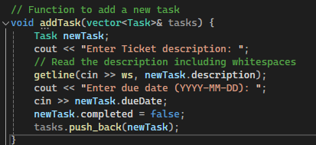
C++ Code :
Functionality - Add Task
Prompts user for task description and due date
Adds the new task to the vector of tasks

Slide 7
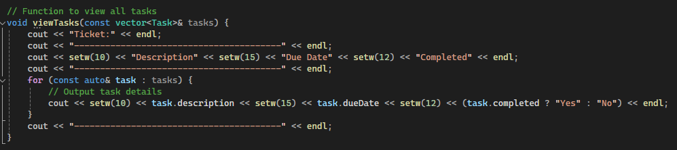
Functionality - View Task : the "viewTasks" function works:Displays all tasks with their descriptions, due dates, and completion status

Slide 8
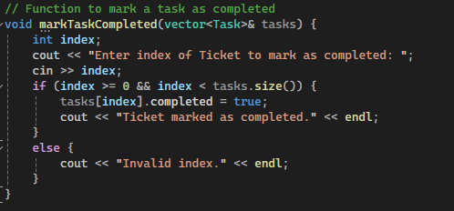
Functionality - Mark Task as Completed the "markTaskCompleted" function works:Prompts user to enter the index of the task to mark as completed Updates the completion status of the selected task

Slide 9
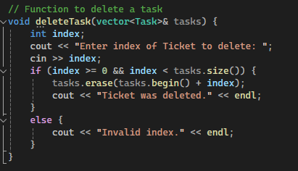
Functionality - Delete Task the "deleteTask" function works:Prompts user to enter the index of the task to delete Removes the selected task from the vector of tasks

Slide 10
#include <iostream>
#include <fstream>
#include <vector>
#include <string>
#include <iomanip>
using namespace std;
// Structure to represent a task
struct Task {
string description;
string dueDate;
bool completed;
};
// Function to add a new task
void addTask(vector<Task>& tasks) {
Task newTask;
cout << "Enter Ticket description: ";
// Read the description including whitespaces
getline(cin >> ws, newTask.description);
cout << "Enter due date (YYYY-MM-DD): ";
cin >> newTask.dueDate;
newTask.completed = false;
tasks.push_back(newTask);
}

Slide 11
/ Function to view all tasks
void viewTasks(const vector<Task>& tasks) {
cout << "Ticket:" << endl;
cout << "----------------------------------------" << endl;
cout << setw(10) << "Description" << setw(15) << "Due Date" << setw(12) << "Completed" << endl;
cout << "----------------------------------------" << endl;
for (const auto& task : tasks) {
// Output task details
cout << setw(10) << task.description << setw(15) << task.dueDate << setw(12) << (task.completed ? "Yes" : "No") << endl;
}
cout << "----------------------------------------" << endl;
}
// Function to mark a task as completed
void markTaskCompleted(vector<Task>& tasks) {
int index;
cout << "Enter index of Ticket to mark as completed: ";
cin >> index;
if (index >= 0 && index < tasks.size()) {
tasks[index].completed = true;
cout << "Ticket marked as completed." << endl;
}
else {
cout << "Invalid index." << endl;
}
}

Slide 12
// Function to delete a task
void deleteTask(vector<Task>& tasks) {
int index;
cout << "Enter index of Ticket to delete: ";
cin >> index;
if (index >= 0 && index < tasks.size()) {
tasks.erase(tasks.begin() + index);
cout << "Ticket was deleted." << endl;
}
else {
cout << "Invalid index." << endl;
}
}
// Function to save tasks to a file
void saveTasksToFile(const vector<Task>& tasks, const string& filename) {
ofstream outFile(filename);
if (outFile.is_open()) {
for (const auto& task : tasks) {
// Save task details to file
outFile << task.description << "," << task.dueDate << "," << (task.completed ? "1" : "0") << endl;
}
cout << "Ticket saved to " << filename << endl;
}
else {
cout << "Error: Unable to open file for writing." << endl;
}
}

Slide 13
// Function to load tasks from a file
void loadTasksFromFile(vector<Task>& tasks, const string& filename) {
ifstream inFile(filename);
if (inFile.is_open()) {
tasks.clear();
string line;
while (getline(inFile, line)) {
Task task;
size_t commaPos = line.find(',');
// Parse task details from file
task.description = line.substr(0, commaPos);
line.erase(0, commaPos + 1);
commaPos = line.find(',');
task.dueDate = line.substr(0, commaPos);
line.erase(0, commaPos + 1);
task.completed = (line == "1");
tasks.push_back(task);
}
cout << "Ticket loaded from " << filename << endl;
}
else {
cout << "Error: Unable to open file for reading. Creating new file." << endl;
// Attempt to create the file if it doesn't exist
ofstream outFile(filename);
if (!outFile.is_open()) {
cout << "Error: Unable to create file." << endl;
}
}
}

Slide 14
switch (choice) {
case 1:
addTask(tasks);
break;
case 2:
viewTasks(tasks);
break;
case 3:
markTaskCompleted(tasks);
break;
case 4:
deleteTask(tasks);
break;
case 5:
saveTasksToFile(tasks, filename);
break;
case 6:
cout << "Exiting program. Saving tasks..." << endl;
saveTasksToFile(tasks, filename);
break;
default:
cout << "Invalid choice. Please enter a number between 1 and 6." << endl;
}
} while (choice != 6);
return 0;
}
int main() {
vector<Task> tasks;
string filename = "tasks.txt";
loadTasksFromFile(tasks, filename);
int choice;
do {
cout << "\nTask Management System" << endl;
cout << "1. Add Ticket" << endl;
cout << "2. View Ticket" << endl;
cout << "3. Mark Ticket as Completed" << endl;
cout << "4. Delete Ticket" << endl;
cout << "5. Save Ticket" << endl;
cout << "6. Exit" << endl;
cout << "Enter your choice: ";
cin >> choice;

Slide 15
Thank You

